Slide 2

Sentiment_Analysis_Tripadvisor_reviews
Rachad_RAAD / Dec_2022

Slide 3
Objective of the Analysis This end to end sentiment analysis (NLP) and prediction routine is based on TripAdvisor's hotel reviews, this data set has two columns Review and Ratings. The objective of this analysis cum prediction routine is to identify sentiments for the reviews posted by various customers using Sentiment Analyser and later created a model to predict the sentiment scores based on the input text. The dataset is downloaded from Kaggle (https://www.kaggle.com/rmisra/news-category-dataset)

Slide 4
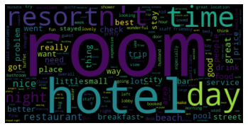
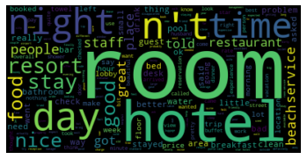
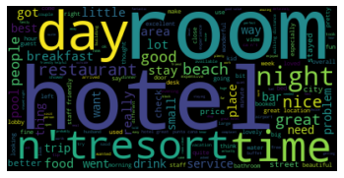
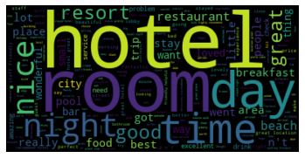
Word cloud by rating
Representing text data in which the size of each word indicates its frequency or importance
5 Stars
4 Stars
3 Stars
2 Stars
1 Star
Reviews
Reviews
Reviews
Reviews
Reviews

Slide 5
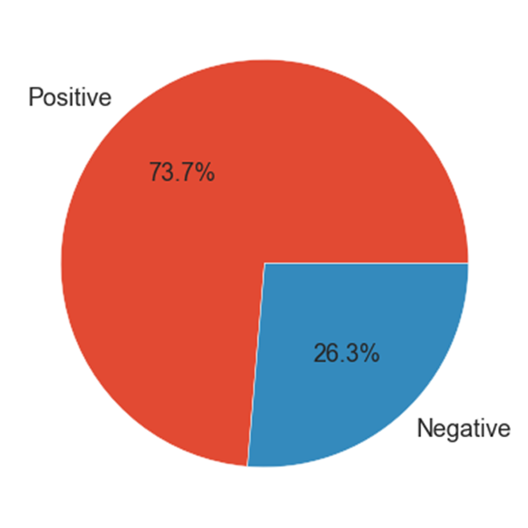
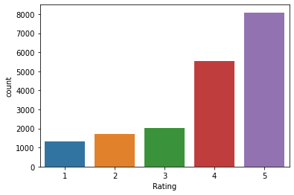
Rating
From the below two graphs, we can see that most of the customer rating is within the positive zone (high = 4-5). This leads us to believe that most reviews will be pretty positive too
.​
The percentage (rounded) rating
5 stars = 44%
4 stars = 30%
3 stars = 10%
2 stars = 9%
1 Star = 7%

Slide 6
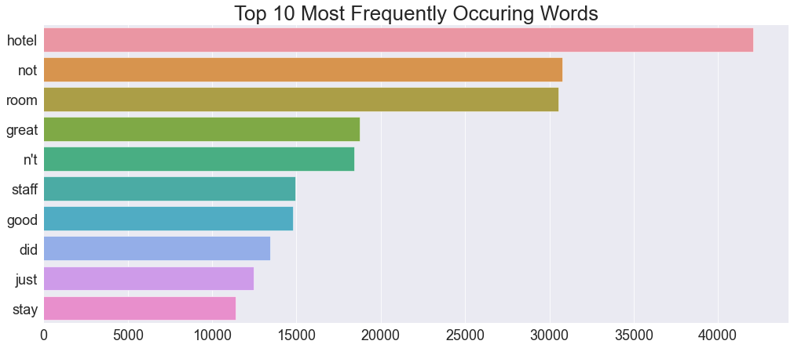
Top Frequent words from raw data

Slide 7
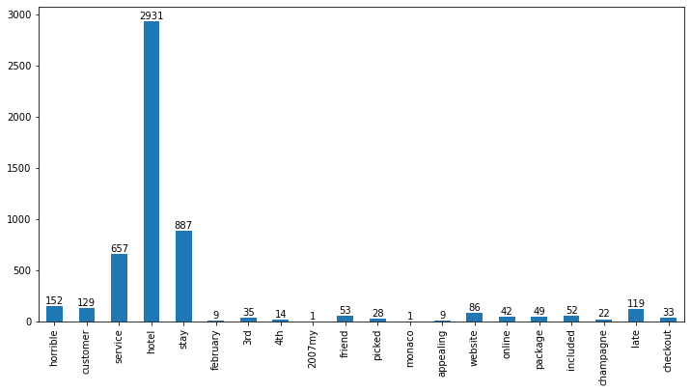
Most frequent word after data cleaning

Slide 8
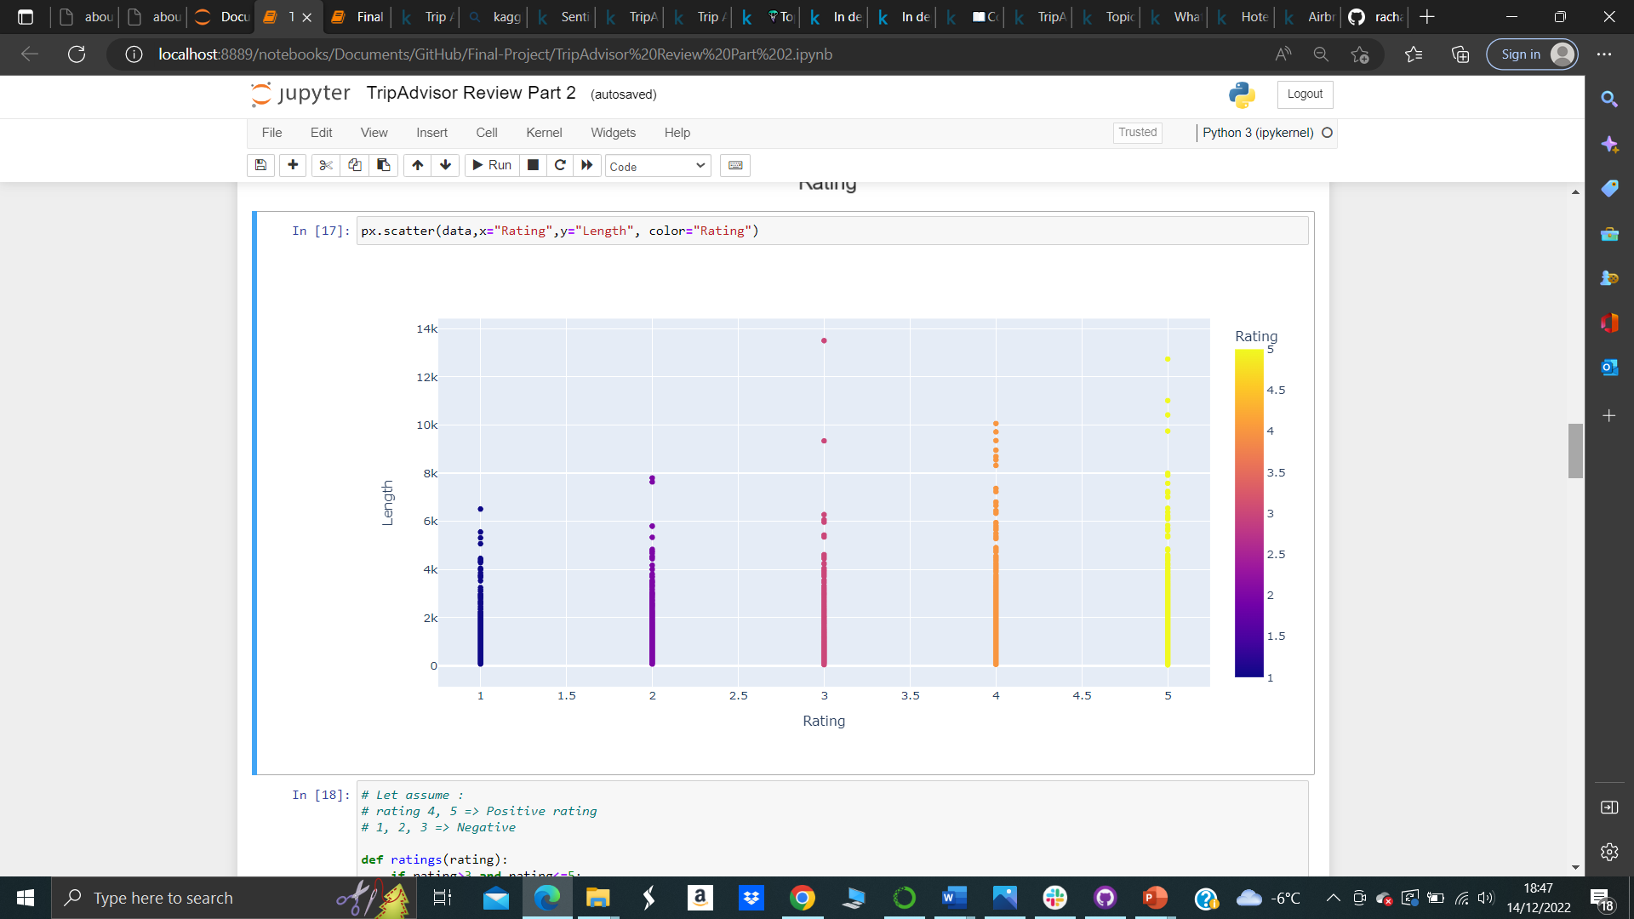
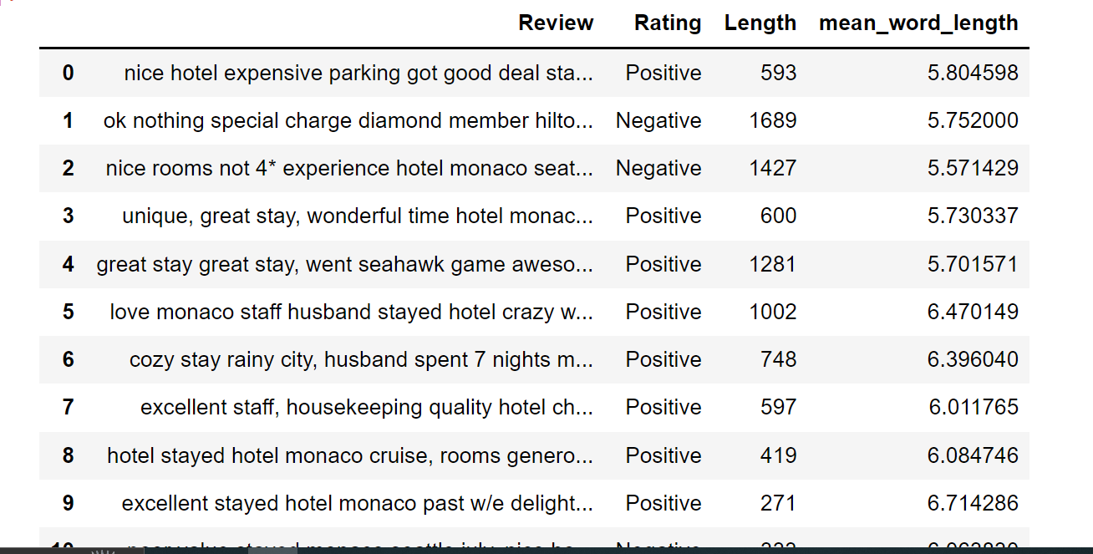
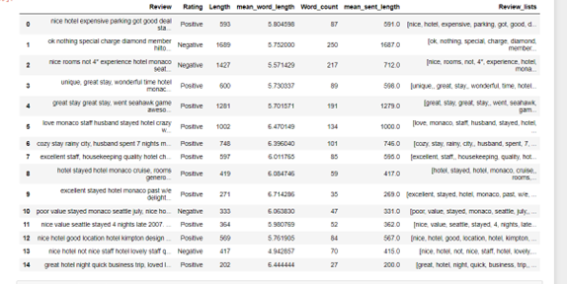
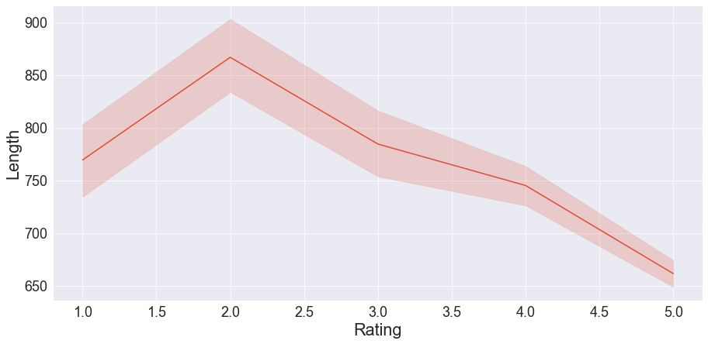
length reviews effect in the rating (length is high in negative reviews where short in positives ones)
Review | Rating | Length | mean_word_length | Word_count
0 | nice hotel expensive parking got good deal sta... | Posive | 593 | 5.804598 | 87
1 | ok nothing special charge diamond member hilto... | Negative | 1689 | 5.752000 | 250
2 | nice rooms not 4* experience hotel monaco seat... | Negative | 1427 | 5.571429 | 217
3 | unique, great stay, wonderful time hotel monac... | Positive | 600 | 5.730337 | 89
4 | great stay great stay, went seahawk game aweso... | Positive | 1281 | 5.701571 | 191
5 | love monaco staff husband stayed hotel crazy w... | Positive | 1002 | 6.470149 | 134
6 | cozy stay rainy city, husband spent 7 nights m... | Positive | 748 | 6.396040 | 101
7 | excellent staff, housekeeping quality hotel ch... | Positive | 597 | 6.011765 | 85
8 | hotel stayed hotel monaco cruise, rooms genero... | Positive | 419 | 6.084746 | 59
9 | excellent stayed hotel monaco past w/e delight... | Positive | 271 | 6.714286 | 35
10 | poor value stayed monaco seattle july, nice ho... | Negative | 333 | 6.063830 | 47
11 | nice value seattle stayed 4 nights late 2007. ... | Positive | 364 | 5.980769 | 52
12 | nice hotel good location hotel kimpton design ... | Positive | 569 | 5.761905 | 84
13 | nice hotel not nice staff hotel lovely staff q... | Negative | 417 | 4.942857 | 70
14 | great hotel night quick business trip, loved l... | Positive | 202 | 6.444444 | 27
15 | horrible customer service hotel stay february ... | Negative | 1411 | 5.588785 | 214
16 | disappointed say anticipating stay hotel monac... | Negative | 1662 | 5.863636 | 242
17 | fantastic stay monaco seattle hotel monaco hol... | Positive | 1067 | 6.402778 | 144
18 | good choice hotel recommended sister, great lo... | Positive | 164 | 6.409091 | 22
19 | hmmmmm say really high hopes hotel monaco chos... | Negative | 1025 | 5.564103 | 156
20 | service service service spent week g-friend la... | Positive | 1182 | 5.906433 | 171
21 | excellent stay, delightful surprise stay monac... | Positive | 178 | 7.428571 | 21
22 | good value downtown hotel monaco seattle great... | Positive | 327 | 6.086957 | 46
23 | hotel monaco great location service hotel mona... | Positive | 941 | 6.286822 | 129
24 | great location need internally upgrade advanta... | Negative | 250 | 6.114286 | 35
25 | n't mind noise place great, read reviews noise... | Negative | 482 | 5.871429 | 70
26 | loved, stayed warwick overnight getway enjoy c... | Positive | 322 | 6.642857 | 42
27 | met expectations centrally located hotel block... | Negative | 538 | 6.671429 | 70
28 | nice hotel husband stayed warwick 4 years ago ... | Positive | 1083 | 5.891720 | 157
29 | good hotel not large hotel newly decorated, ro... | Positive | 237 | 5.941176 | 34

Slide 9
Based on the result, We can conclude that There is some Key Aspects which should be considered by Hotel Management, such as: - Hotel Room - Staff/Service - Cleanness/Hygiene - Restaurant/Food - Pool/Beach
The overall benefits of sentiment analysis include - Sorting Data at Scale - Real-Time Analysis - Discovering New Marketing Strategies

Slide 10
End notes
The model reaches around 54% accuracy where 70% for Rate 5 and 53% for Rate 1( and there is a lot of space for improvement)
Classes 1,2,3 are underrepresented, balancing may help but it will reduce a lot the total size of the dataset
We can test the model performance with longer max sequence length (will increase the memmory usage and computation time)
Text analysis and cleaning unnecessary information should give positive impact on the performance
Learning rate optimization will probably improve the results
.

Slide 11
THANK YOU
Rachad RAAD
https://www.linkedin.com/in/rachad-raad-12a21a247/r
https://github.com/rachad-de

